Slide 1


Foundations of
Scientific Computing
(SciComp 101)
Dave Biersach
dbiersach@bnl.gov
Session 07 Trigonometry and Polar Graphs

Slide 2
Session 07 – Goals
This session is to reinforce skills using numpy vectorized operations and drawing graphs with matplotlib
Trigonometry allows us to convert Polar coordinates to Cartesian coordinates – if you haven’t covered this yet in your math class, don’t worry – glide with it
This session also seeks to affirm the importance of being able to derive from first principles classic formulas that thus far have just been handed to you – do more than memorize!
We will also cover how to generate random numbers, plot using Polar projections, and several topics from computational geometry

Slide 3
Careful Proofs
a = b
a² = ab
a² + (a² – 2ab) = ab + (a² – 2ab)
2(a² – ab) = a² – ab
2(a² – ab)/(a² – ab) = (a² – ab)/(a² – ab)
2 = 1
Where did we go wrong?

Slide 4

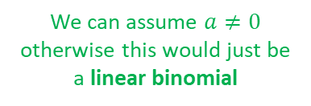
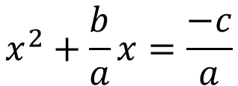
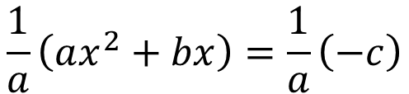

Completing What Square?
Where does the quadratic formula come from?
$$ax^{2}+bx+c=0$$
$$ax^{2}+bx=−c$$
$$\frac{1}{a}\left(ax^{2}+bx\right)=\frac{1}{a}\left(−c\right)$$
We can assume $a≠0$ otherwise this would just be a linear binomial
$$x^{2}+\frac{b}{a}x=\frac{−c}{a}$$

Slide 5
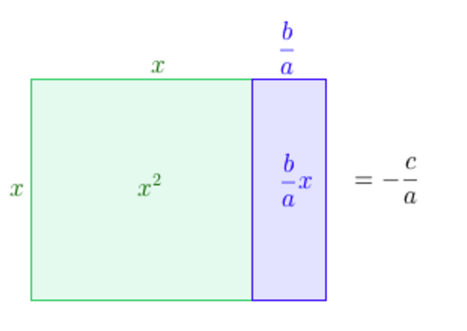
Completing What Square?
$$x^{2}+\frac{b}{a}x=\frac{−c}{a}$$

Slide 6
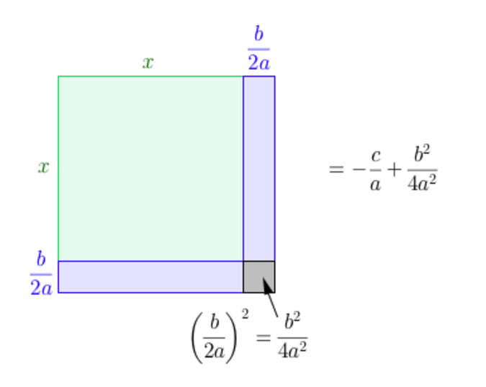
Completing What Square?
That square!

Slide 7
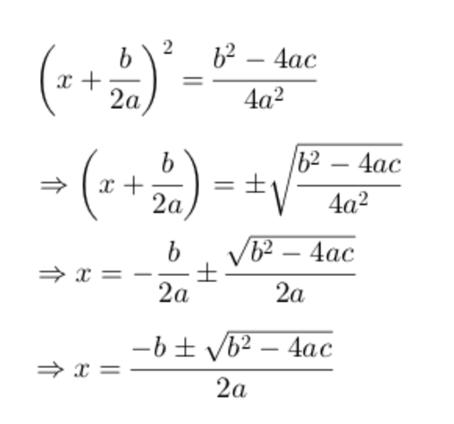
Completing What Square?

Slide 8
Prove: a² + b² = c²
c
a
b

Slide 9
Prove: a² + b² = c²
c
c
a
b
b
a

Slide 10
Prove: a² + b² = c²
b
a
c
c
c
a
b
b
a

Slide 11
Prove: a² + b² = c²

Slide 12
Prove: a² + b² = c²
Area of Outer Square
(a + b)² = a² + 2ab + b²
a
b
a
b
a
b
b
a

Slide 13
Prove: a² + b² = c²
Area of Outer Square
(a + b)² = a² + 2ab + b²
Area of Inner Triangles
4 × [(a × b) / 2] = 2ab
a
b
a
b
a
b
b
a

Slide 14
Prove: a² + b² = c²
Area of Outer Square
(a + b)² = a² + 2ab + b²
Area of Inner Triangles
4 × [(a × b) / 2] = 2ab
Area of Inner Square
c²
c
c
c
c

Slide 15
Prove: a² + b² = c²
Area of Outer Square
(a + b)² = a² + 2ab + b²
Area of Inner Triangles
4 × [(a × b) / 2] = 2ab
Area of Inner Square
c²
Area of Outer Square – Area of Triangles =
Area of Inner Square
[a² + 2ab + b²] – 2ab = c²
a² + b² = c²
a
b
a
b
c
c
c
c
a
b
b
a

Slide 16
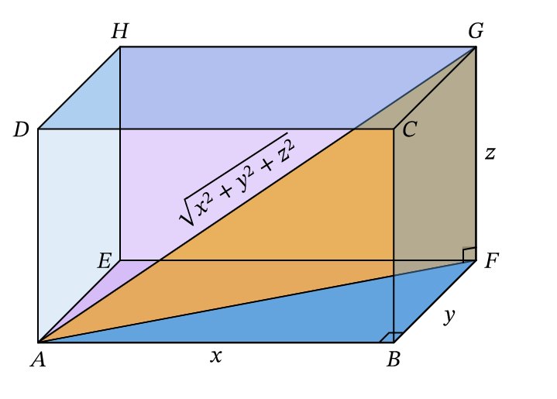
Pythagorean Theorem

Slide 17
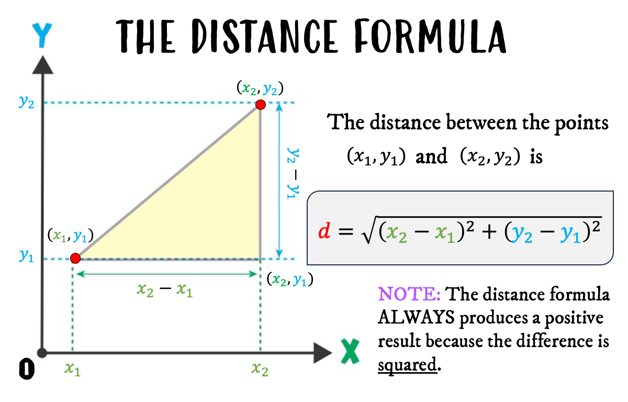
Pythagorean Theorem

Slide 18
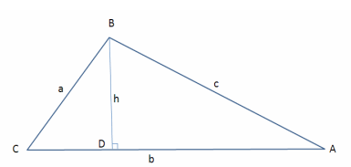


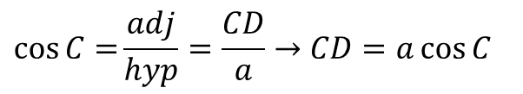






The Generalized Pythagorean Theorem
In $Δ BCD$:
$$\cos{C=}\frac{adj}{hyp}=\frac{CD}{a}→CD=a\cos{C}$$
$$\sin{C}=\frac{opp}{hyp}=\frac{BD}{a}→BD=a\sin{C}$$
In $Δ ABC$:
$$AD=b−CD=b−a\cos{C}$$
In $Δ ABD$:
Law of Cosines
$$c^{2}={AD}^{2}+{BD}^{2}$$
Pythagorean Theorem
The square of a side of a triangle equals the sum of the squares of the remaining sides minus twice the product of those sides and the cosine of the angle between them
$$c^{2}={\left(b−a\cos{C}\right)}^{2}+{\left(a\sin{C}\right)}^{2}$$
1
$$c^{2}=a^{2}\left(\sin^{2}{C}+\cos^{2}{C}\right)+b^{2}−2ab\cos{C}$$
$$c^{2}=a^{2}+b^{2}−2ab\cos{C}$$
$$\cos{{90}^{°}}=0$$

Slide 19
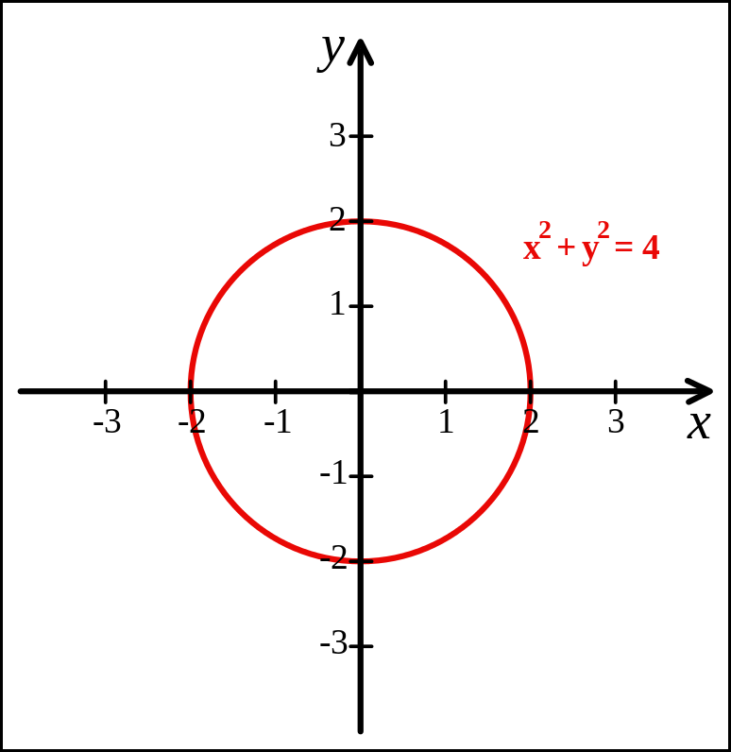
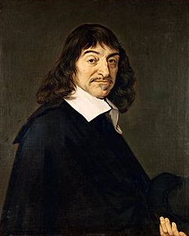
Analytic Geometry
Created by René Descartes in 1637

Slide 20
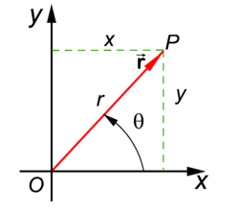
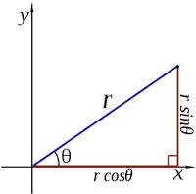
Polar Coordinates
A radius and an angle (theta)
make a 2D polar coordinate
$$(r∗\cos{θ, r ∗ \sin{θ)}}$$

Slide 21
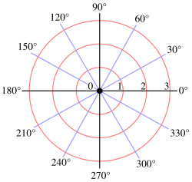
Polar Coordinates

Slide 22
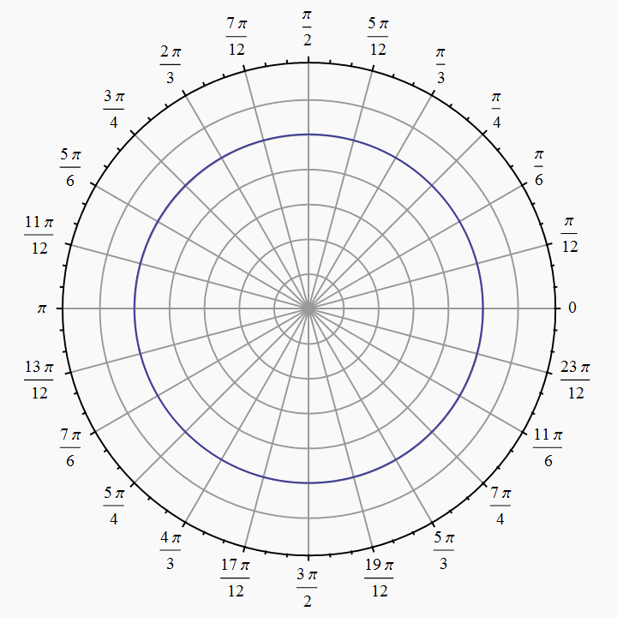
Polar Coordinates
Angles are measured in
radians
(0 ≤ θ ≤ $2π)$

Slide 23
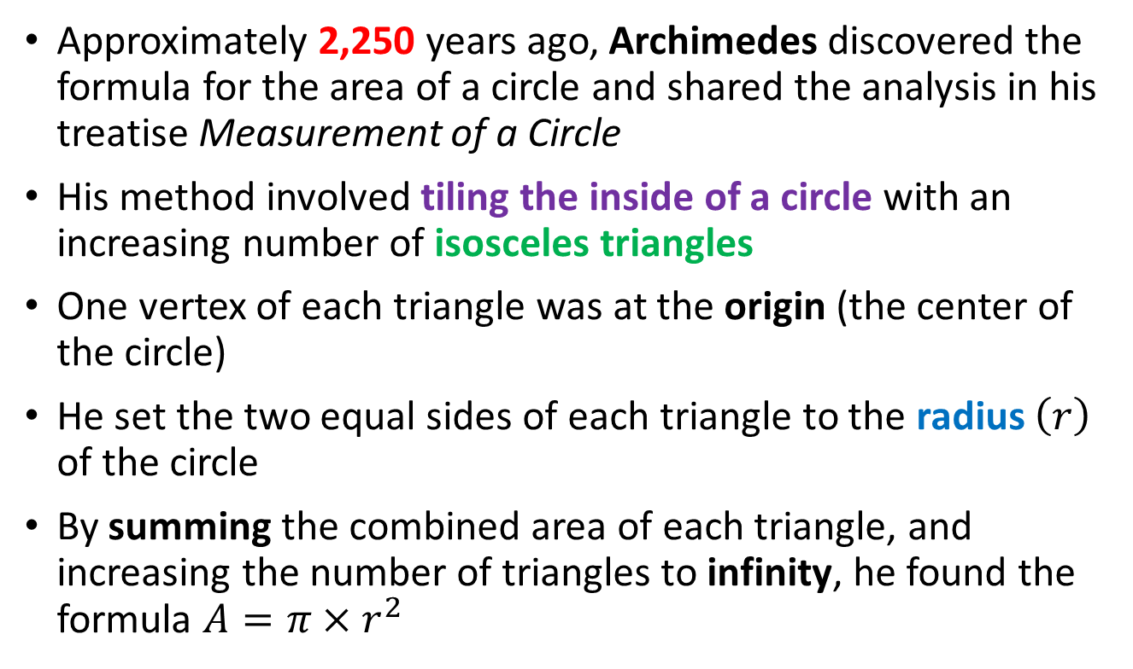
How Archimedes Found the Area of a Circle
Approximately 2,250 years ago, Archimedes discovered the formula for the area of a circle and shared the analysis in his treatise Measurement of a Circle
His method involved tiling the inside of a circle with an increasing number of isosceles triangles
One vertex of each triangle was at the origin (the center of the circle)
He set the two equal sides of each triangle to the radius $\left(r\right)$ of the circle
By summing the combined area of each triangle, and increasing the number of triangles to infinity, he found the formula $A=π×r^{2}$

Slide 24
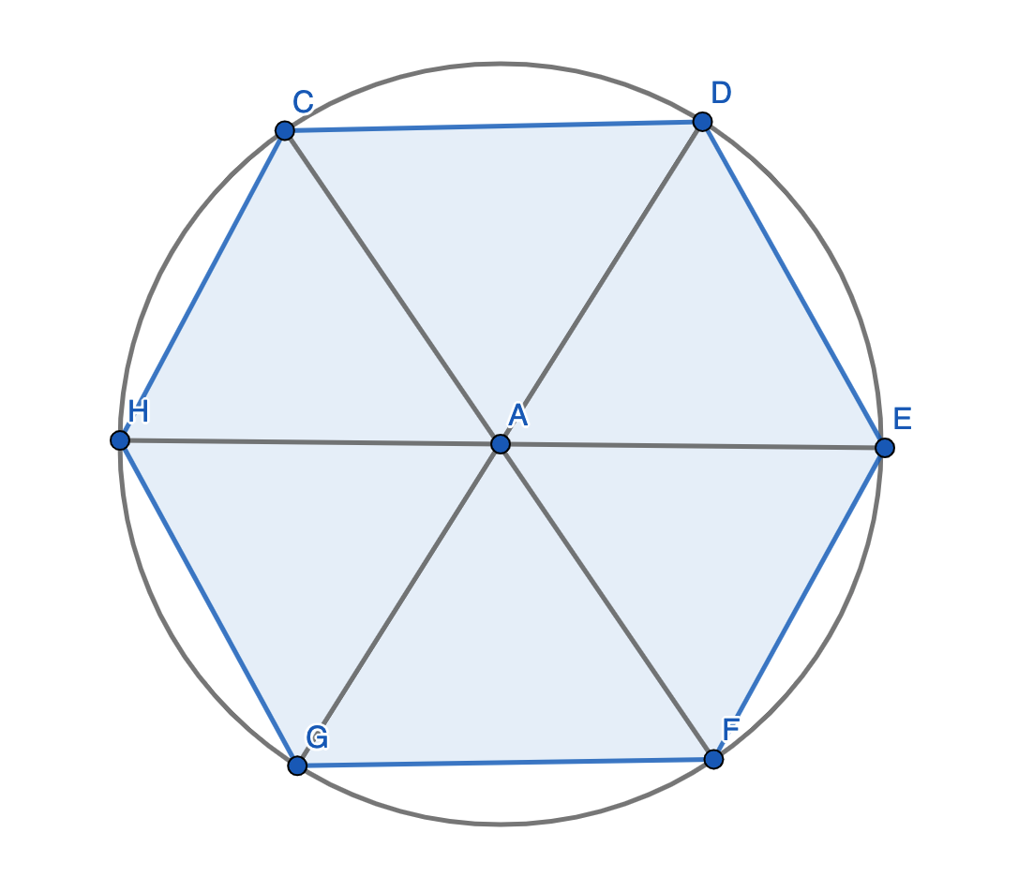
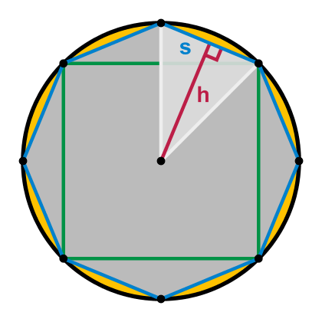
How Archimedes Found the Area of a Circle

Slide 25
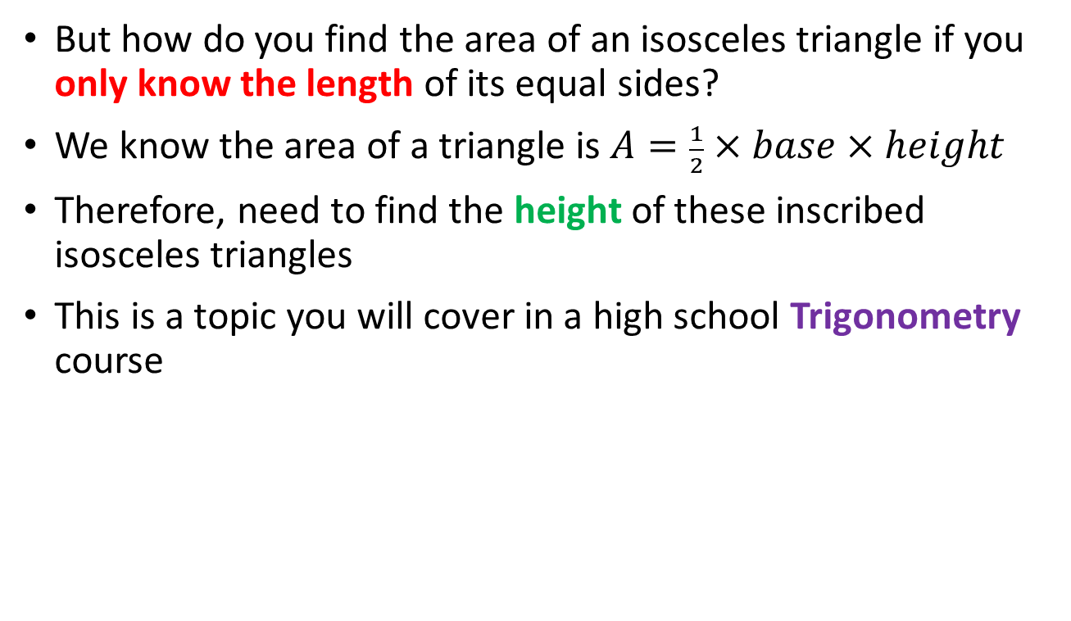
How Archimedes Found the Area of a Circle
But how do you find the area of an isosceles triangle if you only know the length of its equal sides?
We know the area of a triangle is $A=\frac{1}{2}×base×height$
Therefore, need to find the height of these inscribed isosceles triangles
This is a topic you will cover in a high school Trigonometry course

Slide 26
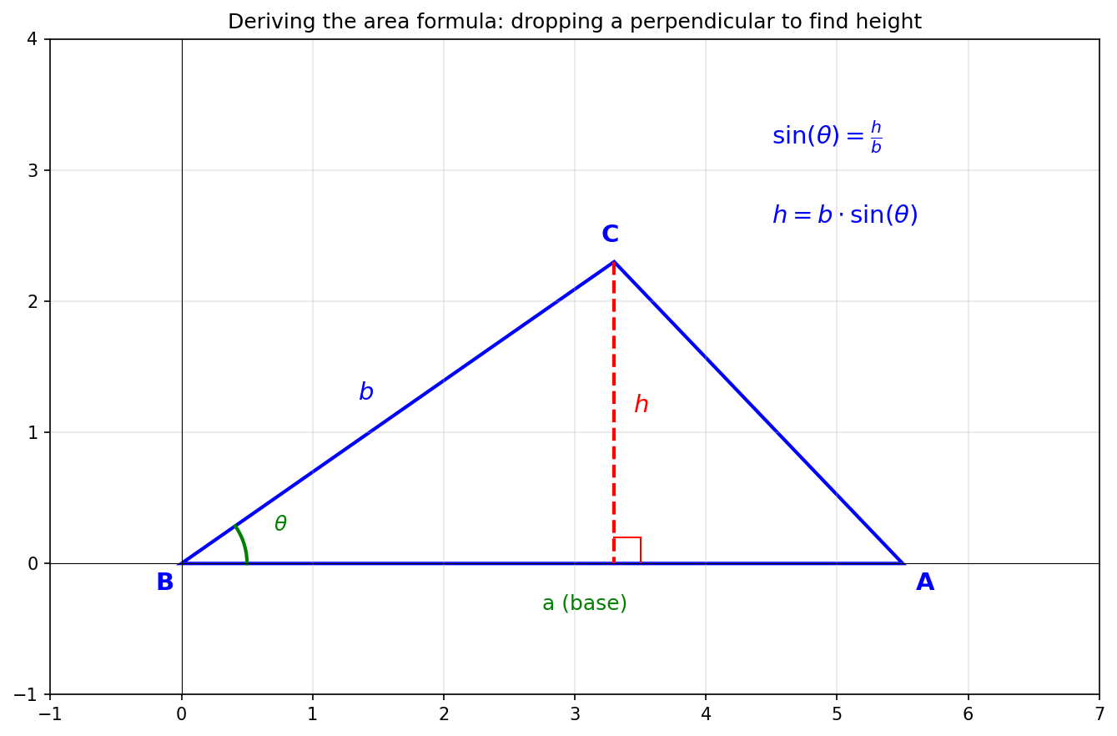

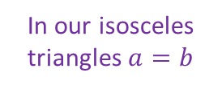



How Archimedes Found the Area of a Circle
$$A=\frac{1}{2}×a×h$$
$$A=\frac{1}{2}×a×b∙\sin{θ}$$
$$A=\frac{1}{2}{ r}^{2}\sin{θ}$$
In our isosceles triangles $a=b$
$$θ$$

Slide 27
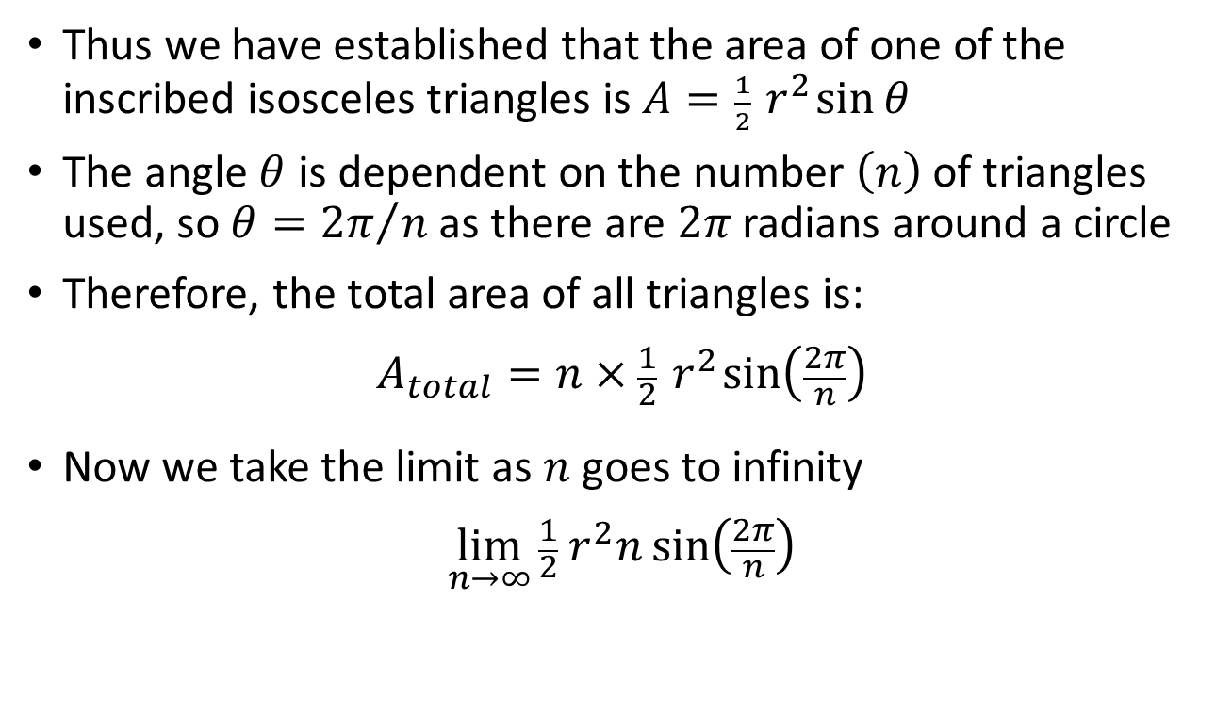
How Archimedes Found the Area of a Circle
Thus we have established that the area of one of the inscribed isosceles triangles is $A=\frac{1}{2}{ r}^{2}\sin{θ}$
The angle $θ$ is dependent on the number $\left(n\right)$of triangles used, so $θ={2π}/n$ as there are $2π$ radians around a circle
Therefore, the total area of all triangles is:
$$A_{total}=n×\frac{1}{2}{ r}^{2}\sin\left(\frac{2π}{n}\right)$$
Now we take the limit as $n$ goes to infinity
$$\lim_{n→∞}{\frac{1}{2}{ r}^{2}n\sin\left(\frac{2π}{n}\right)}$$

Slide 28
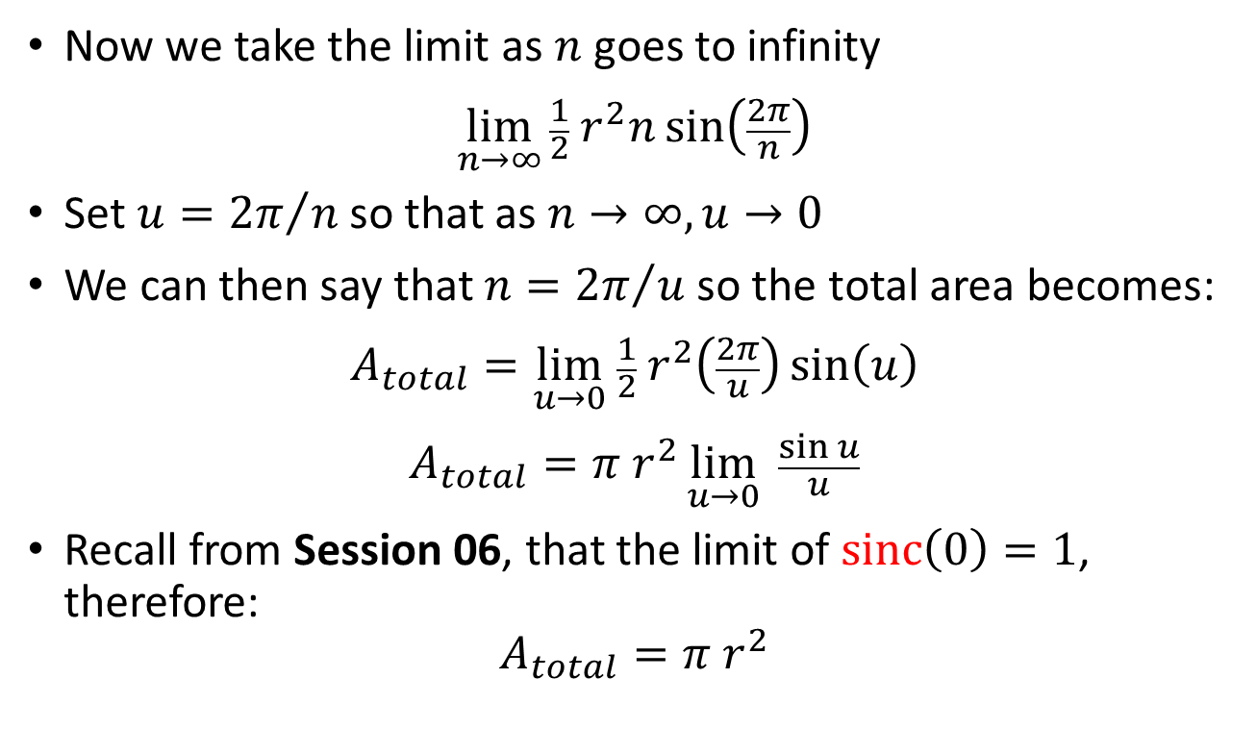
How Archimedes Found the Area of a Circle
Now we take the limit as $n$ goes to infinity
$$\lim_{n→∞}{\frac{1}{2}{ r}^{2}n\sin\left(\frac{2π}{n}\right)}$$
Set $u={2π}/n$ so that as $n→∞,u→0$
We can then say that $n={2π}/u$ so the total area becomes:
$$A_{total}=\lim_{u→0} \frac{1}{2}{ r}^{2}\left(\frac{2π}{u}\right)\sin\left(u\right)$$
$$A_{total}=π{ r}^{2}\lim_{u→0}{\frac{\sin{u}}{u}}$$
Recall from Session 06, that the limit of $\operatorname{sinc}\left(0\right)=1$, therefore:
$$A_{total}=π{ r}^{2}$$
Via u-substitution
1
Simplify

Slide 29
The Shoelace Formula
How would you find the circumference and area of a polygon if all you were given were its vertices?
For circumference, we could just sum the Pythagorean (straight line) distance between successive vertices all around the perimeter (from 1st vertex back to 1st vertex)
But to find the enclosed area, we can use the shoelace formula that implements a clever sum of trapezoids
If our shape is curved, we can approximate it by using many vertices spread around its perimeter
The shoelace formula will still work even for rounded shapes – the more vertices we use, the better our estimate for the enclosed area

Slide 30
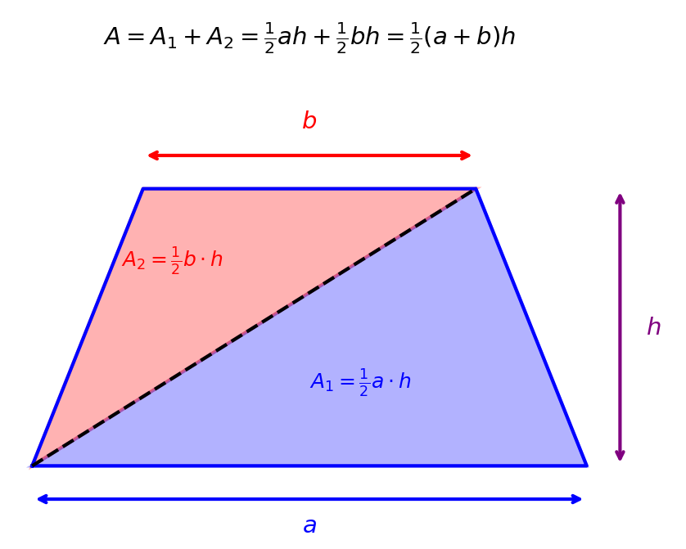
Area of a Trapezoid

Slide 31
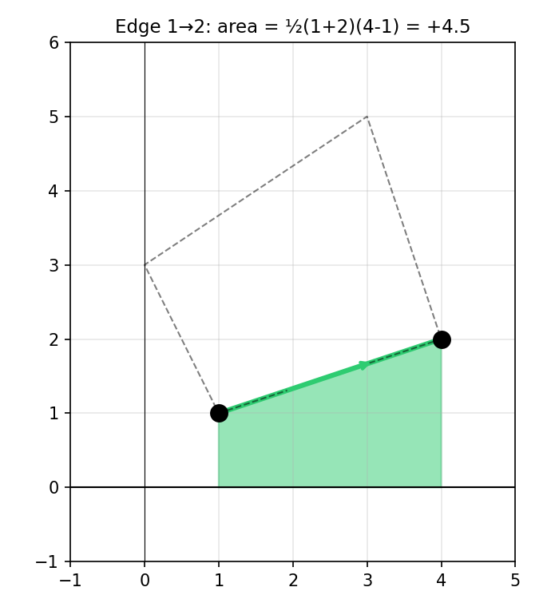

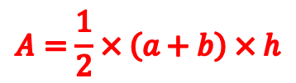
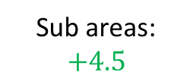







The Shoelace Formula
When moving right, add the area of the trapezoid
Sub areas:
$$+4.5$$
3
$$A=\frac{1}{2}×\left(a+b\right)×h$$
$$4$$
2
$$1$$
$$b$$
$$a$$
$$a=y_{\left(from\right)}$$
$$h$$
$$b=y_{\left(to\right)}$$
$$h=x_{\left(to\right)}−x_{\left(from\right)}$$
$$A_{1}=\frac{1}{2}\left(y_{1}+y_{2}\right)\left(x_{2}−x_{1}\right)$$

Slide 32
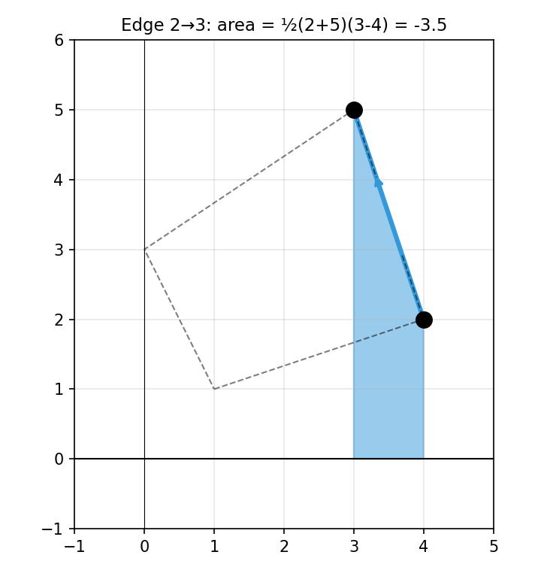
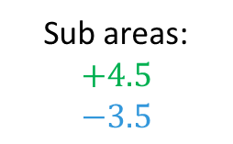

The Shoelace Formula
When moving right, add the area of the trapezoid
Sub areas:
$$+4.5$$
$$−3.5$$
3
When moving left, subtract the area of the trapezoid
$$4$$
2
$$1$$
$$a=y_{\left(from\right)}$$
$$b=y_{\left(to\right)}$$
$$h=x_{\left(to\right)}−x_{\left(from\right)}$$
$$A_{2}=\frac{1}{2}\left(y_{2}+y_{3}\right)\left(x_{3}−x_{2}\right)$$

Slide 33
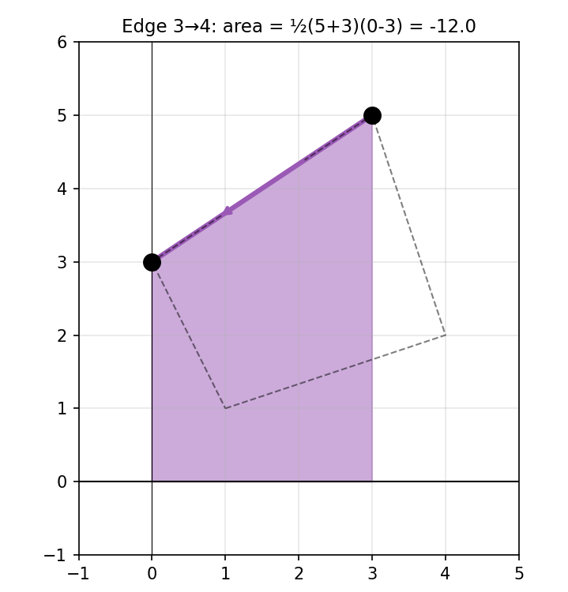
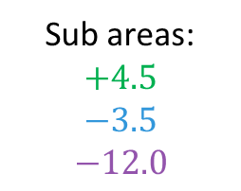

The Shoelace Formula
When moving right, add the area of the trapezoid
Sub areas:
$$+4.5$$
$$−3.5$$
$$−12.0$$
3
When moving left, subtract the area of the trapezoid
$$4$$
2
$$1$$
$$a=y_{\left(from\right)}$$
$$b=y_{\left(to\right)}$$
$$h=x_{\left(to\right)}−x_{\left(from\right)}$$
$$A_{3}=\frac{1}{2}\left(y_{3}+y_{4}\right)\left(x_{4}−x_{3}\right)$$

Slide 34
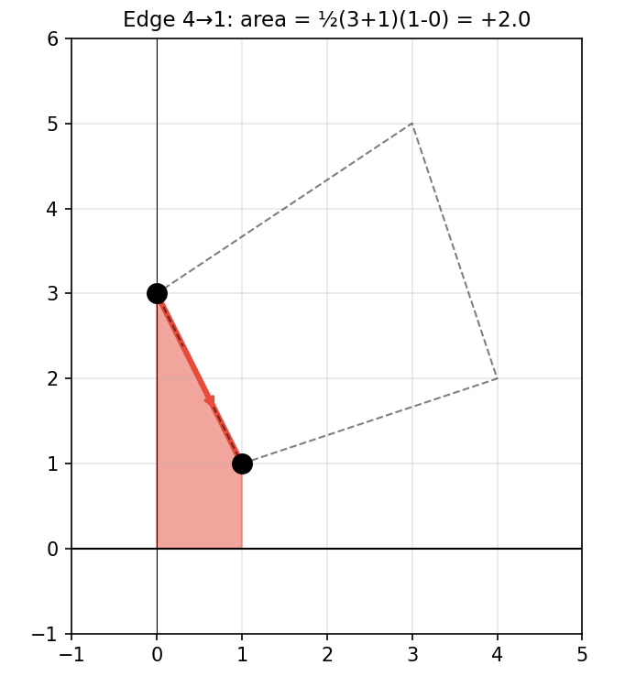
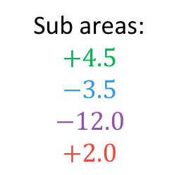

The Shoelace Formula
When moving right, add the area of the trapezoid
Sub areas:
$$+4.5$$
$$−3.5$$
$$−12.0$$
$$+2.0$$
3
When moving left, subtract the area of the trapezoid
$$4$$
2
$$1$$
$$a=y_{\left(from\right)}$$
$$b=y_{\left(to\right)}$$
$$h=x_{\left(to\right)}−x_{\left(from\right)}$$
$$A_{4}=\frac{1}{2}\left(y_{4}+y_{1}\right)\left(x_{1}−x_{4}\right)$$

Slide 35
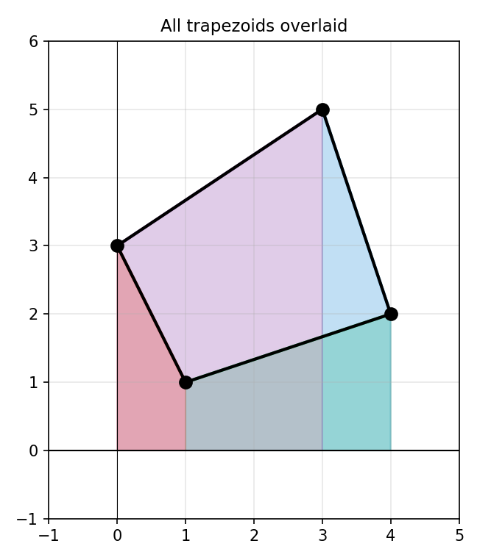
The Shoelace Formula
When moving right, add the area of the trapezoid
Sub areas:
$$+4.5$$
$$−3.5$$
$$−12.0$$
$$+2.0$$
When moving left, subtract the area of the trapezoid

Slide 36
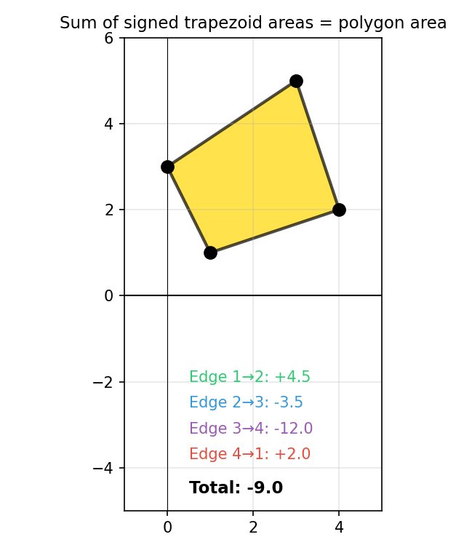


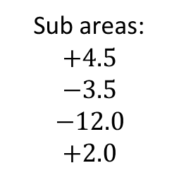





The Shoelace Formula
When moving right, add the area of the trapezoid
Sub areas:
$$+4.5$$
$$−3.5$$
$$−12.0$$
$$+2.0$$
When moving left, subtract the area of the trapezoid
$$−9.0$$
$$Area=\left|sum\right|$$
$$A_{1}=\frac{1}{2}\left(y_{1}+y_{2}\right)\left(x_{2}−x_{1}\right)$$
$$Area=9.0$$
$$A_{2}=\frac{1}{2}\left(y_{2}+y_{3}\right)\left(x_{3}−x_{2}\right)$$
$$A_{3}=\frac{1}{2}\left(y_{3}+y_{4}\right)\left(x_{4}−x_{3}\right)$$
$$A_{4}=\frac{1}{2}\left(y_{4}+y_{1}\right)\left(x_{1}−x_{4}\right)$$

Slide 37
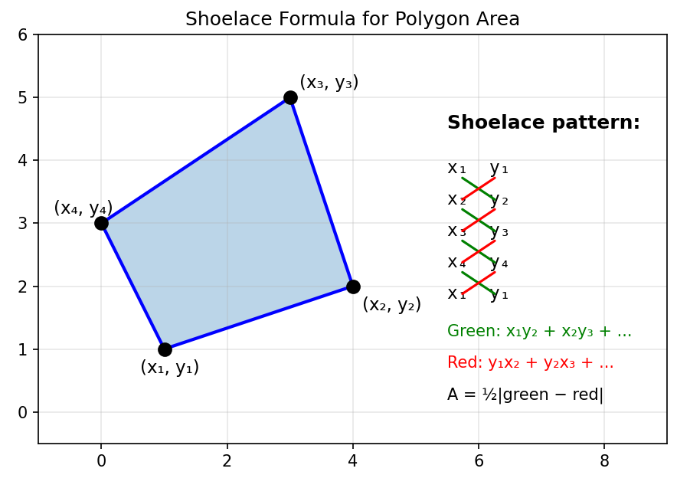
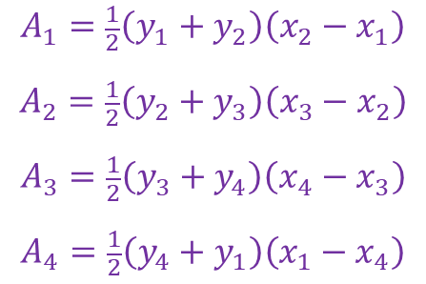

Slide 38
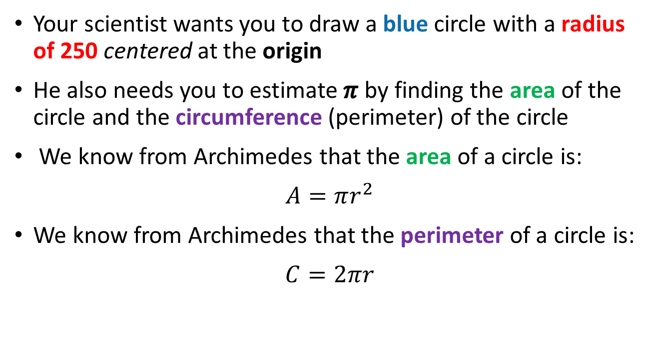
Polar to Cartesian Coordinate Conversion
Your scientist wants you to draw a blue circle with a radius of 250 centered at the origin
He also needs you to estimate $π$ by finding the area of the circle and the circumference (perimeter) of the circle
We know from Archimedes that the area of a circle is:
$$A=πr^{2}$$
We know from Archimedes that the perimeter of a circle is:
$$C=2πr$$

Slide 39
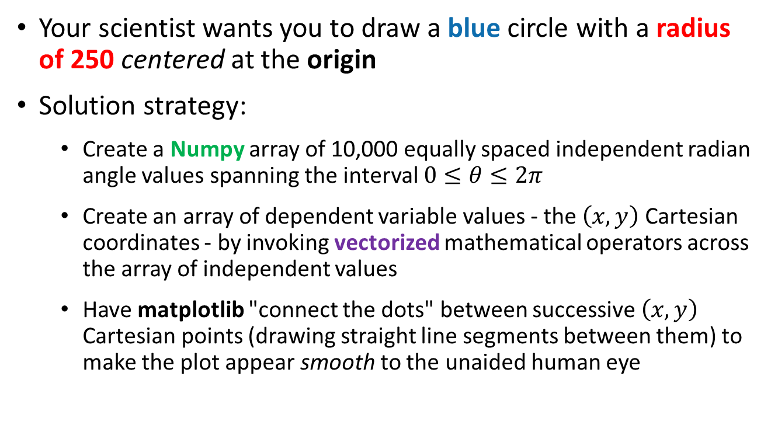
Polar to Cartesian Coordinate Conversion
Your scientist wants you to draw a blue circle with a radius of 250 centered at the origin
Solution strategy:
Create a Numpy array of 10,000 equally spaced independent radian angle values spanning the interval $0≤θ≤2π$
Create an array of dependent variable values - the $\left(x,y\right)$ Cartesian coordinates - by invoking vectorized mathematical operators across the array of independent values
Have matplotlib "connect the dots" between successive $\left(x,y\right)$ Cartesian points (drawing straight line segments between them) to make the plot appear smooth to the unaided human eye

Slide 40
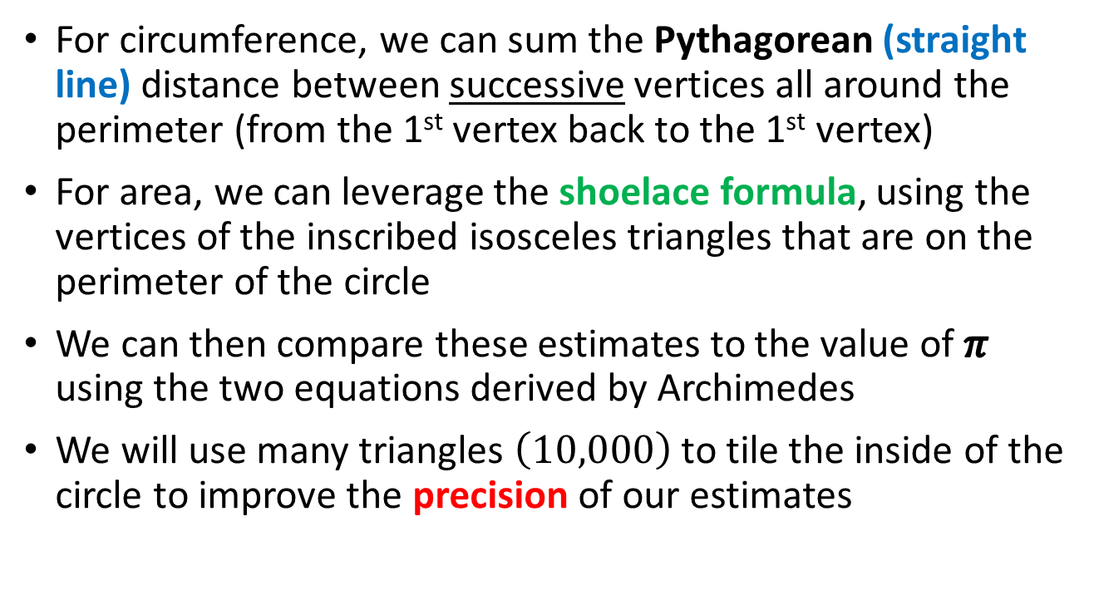
Polar to Cartesian Coordinate Conversion
For circumference, we can sum the Pythagorean (straight line) distance between successive vertices all around the perimeter (from the 1st vertex back to the 1st vertex)
For area, we can leverage the shoelace formula, using the vertices of the inscribed isosceles triangles that are on the perimeter of the circle
We can then compare these estimates to the value of $π$ using the two equations derived by Archimedes
We will use many triangles $\left(10,000\right)$ to tile the inside of the circle to improve the precision of our estimates

Slide 41
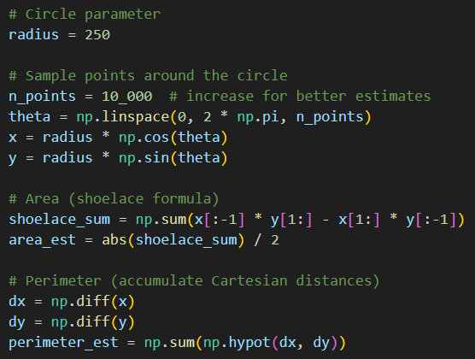
Open trig_circle.py
DO NOT edit
this code
①
②
③
④
Polar to Cartesian coordinate conversion
⑤
⑥
⑦
⑧

Slide 42
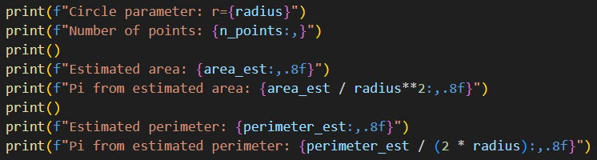
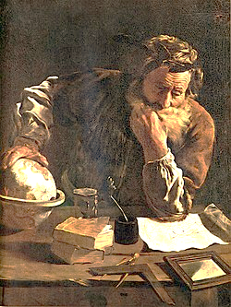


View trig_circle.py
①
②
From
Area
From
Circumference
③
$$π=\frac{A}{r^{2}}$$
$$π=\frac{C}{2r}$$
Archimedes
(282-212 BC)

Slide 43
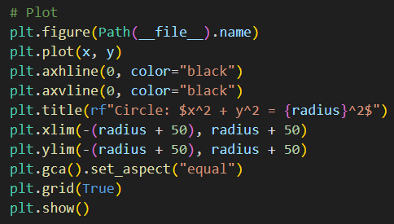
View trig_circle.py
①
②
③
④

Slide 44
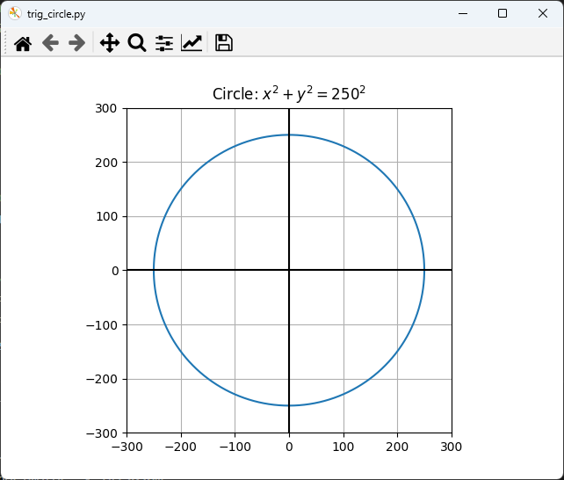
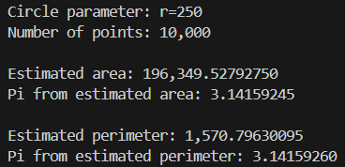
Run trig_circle.py

Slide 45

Drawing the Olympic Rings

Slide 46
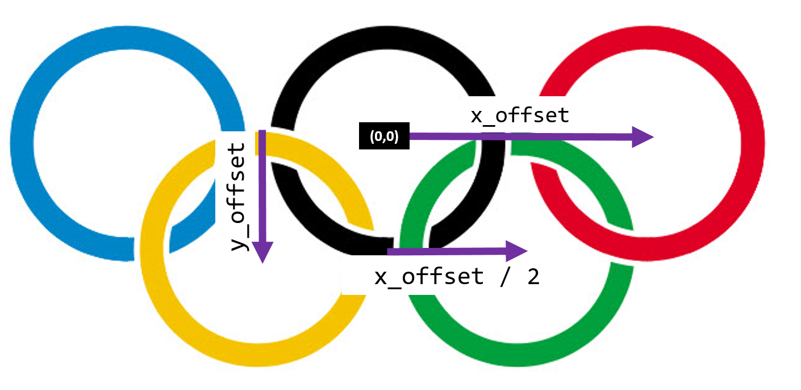
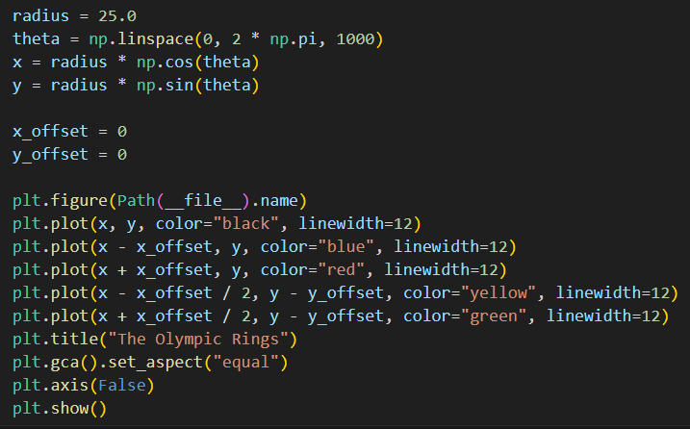
Open olympic_rings.py
DO NOT edit
this code
①
②
③
④
⑤

Slide 47

Run olympic_rings.py
☹

Slide 48
Drawing the Olympic Rings
x_offset
(0,0)
y_offset
x_offset / 2
What should these offsets be to render a correct logo?

Slide 49


Edit olympic_rings.py
You must type in this code
The Greeks loved $ℚ$
No hardcoded lengths!
Offsets should be a function of
radius so the image can scale!

Slide 50

Run olympic_rings.py
☺

Slide 51




Deriving the Equation of an Ellipse
What you were handed:
$$\left(0,b\right)$$
$$d_{2}$$
C
$$\frac{x^{2}}{a^{2}}+\frac{y^{2}}{b^{2}}=1$$
C
a
$$d_{1}$$
But why is this true?
$$\left(0,−b\right)$$
$$d_{1}+d_{2}=constant$$
$$@ \left(x,y\right)=\left(a,0\right)$$
When at point (a,0)
$$d_{1}=\left(−c,0\right)→\left(a,0\right)=a−\left(−c\right)=a+c$$
$$d_{2}=\left(c,0\right)→\left(a,0\right)=a−\left(c\right)=a−c$$
$$\left(a+c\right)+\left(a−c\right)=constant=2a$$

Slide 52

Deriving the Equation of an Ellipse

Slide 53


Deriving the Equation of an Ellipse
If all you can do is spout formulas, but have no intuition where they came from, you are just a highly accomplished parrot.
On occasion, force yourself to rederive
“magic” formulas from first principles!

Slide 54


The Perimeter of a Circle vs. an Ellipse
$$\frac{x^{2}}{a^{2}}+\frac{y^{2}}{b^{2}}=1$$
$$x^{2}+y^{2}=1$$
What is the formula for the circumference of an ellipsis?
$$C=2πr=2π\left(1\right)=2π$$

Slide 55


The Perimeter of an Ellipse
$$\frac{x^{2}}{a^{2}}+\frac{y^{2}}{b^{2}}=1$$
$$x=a\cos{θ}$$
$$L=\int{ds}$$
Arc Length
$$y=b\sin{θ}$$
$$\frac{ds}{dθ}=\sqrt{x^{′}{\left(θ\right)}^{2}+y^{′}{\left(θ\right)}^{2}}$$
$$\frac{{\left(a\cos{θ}\right)}^{2}}{a^{2}}+\frac{{\left(b\sin{θ}\right)}^{2}}{b^{2}}=1$$
$$L=\int{\sqrt{x^{′}{\left(θ\right)}^{2}+y^{′}{\left(θ\right)}^{2}}}dθ$$
$$\frac{{a^{2}\left(\cos{θ}\right)}^{2}}{a^{2}}+\frac{{b^{2}\left(\sin{θ}\right)}^{2}}{b^{2}}=1$$
$$L=\int{\sqrt{a^{2}\sin^{2}\left(θ\right)+b^{2}\cos^{2}\left(θ\right)}}dθ$$
$$\cos^{2}\left(θ\right)+\sin^{2}\left(θ\right)=1$$
$$perimeter=\int_{0}^{2π}{\sqrt{a^{2}\sin^{2}\left(θ\right)+b^{2}\cos^{2}\left(θ\right)}ⅆθ}$$
$∴$ an ellipse is just a circle where x and y coordinates are scaled independently
But we can only estimate this integral numerically!
There is no exact formula for the perimeter of an ellipse!

Slide 56












The Perimeter of an Ellipse
$$\frac{x^{2}}{a^{2}}+\frac{y^{2}}{b^{2}}=1$$
$$x=a\cos{θ}$$
In 1914, Ramanujan offered an approximate formula for the perimeter $\left(p\right)$ of an ellipse:
$$y=b\sin{θ}$$
$a=$ length of semi-major axis
$b=$ length of semi-minor axis
$$C≈π\left(3\left(a+b\right)−\sqrt{\left(3a+b\right)\left(a+3b\right)}\right)$$
$$b$$
$$−a$$
$$a$$
$$−b$$
Srinivasa Ramanujan
(1887-1920, Age 32)
$$L=\int_{0}^{2π}{\sqrt{{(a)}^{2}\sin^{2}\left(θ\right)+b^{2}\cos^{2}\left(θ\right)}}dθ$$

Slide 57

Plotting an Ellipse
Your scientist needs you to write a program to draw an ellipse, where the standard form of an ellipse centered at the origin is:
$$\frac{x^{2}}{a^{2}}+\frac{y^{2}}{b^{2}}=1$$
Your ellipse should have $a=250$ (semi-major axis) and $b=150$ (semi-minor axis)
Using polar coordinates, we could draw it “like” a circle
However, an ellipse has two separate/independent “radii” one for the $x$-axis ($=a$) and one for the $y$-axis ($=b$)
Recall that if $a=b$ we would have a circle

Slide 58


Plotting an Ellipse
He wants to estimate $π$ using the area of the ellipse using the shoelace formula
He also wants to assess the precision of Ramanujan’s formula
We can sum the Pythagorean distance between adjacent vertices to estimate the perimeter of the ellipse
Then we can use Ramanujan’s formula to estimate the perimeter of the ellipse:
$$C≈π\left(3\left(a+b\right)−\sqrt{\left(3a+b\right)\left(a+3b\right)}\right)$$

Slide 59

Open trig_ellipse.py
DO NOT edit
this code
①
②
③
④
Polar to Cartesian coordinate conversion
⑤
⑥
⑦
⑧

Slide 60






View trig_ellipse.py
①
②
③
④
If $a=b$ then we have a circle
$$A=πr^{2}$$
If $a≠b$ then we have an ellipse
$$A=πab$$
$$π=\frac{A}{ab}$$

Slide 61


View trig_ellipse.py
①
②
③
④

Slide 62


Run trig_ellipse.py
Adding 10,000 distance formula calculations together vs. using Ramanujan’s easy functional equation?

Slide 63

Random Walks
Your scientist wants you to create a Python program to display the 2D Cartesian plot of a meandering walker
The walker starts at the (0,0) origin and begins taking one step at a time
At each step, the walker picks a random angle (uniform distribution) within the interval $[0, 2π)$ and moves (from his current position) one unit of distance in that radial direction
Your boss wants your program to show the entire journey of 10,000 random steps in your plot
The research question on the table is this: On average, how far away (Pythagorean distance) from the starting point (the origin) will the walker stop?

Slide 64



Open random_walk.py
DO NOT edit
this code
①
②
③
Pre-allocate an ndarray of size n with all zeros
④
⑤
⑥
A radial unit step in a random direction
⑦
⑧
$$ⅆx$$
$$ⅆy$$
⑨
⑩

Slide 65



Run random_walk.py
Average final distance = $\sqrt{n}$
Stop
Start
Albert Einstein
(1879 – 1955)

Slide 66


Robert Brown
(1773 – 1858)

Slide 67


Slide 68

Uniform (Fair) Sampling in a Circle
Suppose we want to generate evenly distributed random points (no clumps) known to be inside a unit circle centered at the origin
Instead of picking random Cartesian coordinates $\left(x,y\right)$ for the sample points, we could use polar coordinates $\left(r,θ\right)$
We could pick a random radius $\left(0≤r<1\right)$ and a random angle $\left(0≤θ<2π\right)$ and then convert those polar coordinates to Cartesian coordinates
Using this approach, we would never waste time picking random dots that fall outside of the circle, which might happen if we just picked any random $\left(x,y\right)$ pairs of Cartesian coordinates
However, we must still ensure the random sample points are distributed uniformly throughout the inside of the circle to ensure a fair coverage of the entire sample area

Slide 69

Open circle_sampling.py
①
②
③
④
⑤
⑥
⑦

Slide 70

Run circle_sampling.py
What must we do to sample fairly?
What went wrong with our math?

Slide 71



Uniform (Fair) Sampling in a Circle
$$A=πr^{2}$$
Therefore, to equalize the density of each sector, we need to take the square root of each random radius value
The radial area of each sector is growing by a factor of $r^{2}$ as you move away from the origin (0,0)

Slide 72

Edit circle_sampling.py
You must type in this code
①

Slide 73

Run circle_sampling.py
We are now sampling the circle using a uniform (fair) distribution

Slide 74




Parametric Curves

Slide 75


Parametric Curves
Two parameters a, n are used to calculate the current radius $r$ as $θ$sweeps the circle

Slide 76

Parametric Curves

Slide 77

Using a Polar Projection
Your scientist needs you to plot an Archimedes Spiral where $r=θ$ and it rotates from $0≤θ≤8π$
She would like you to plot this curve using the Polar Projection supported by matplotlib
She also needs you to calculate the perimeter (the total distance travelled from the origin) along that spiral by summing the Cartesian distance between successive points
She would also like you to calculate the arc length integral using the above stated limits of the curve

Slide 78














$$\frac{dr}{dθ}=1$$
$$x=r\cos\left(θ\right)$$
$$y=r\sin\left(θ\right)$$
$$d\left(f∙g\right)=f^{′}∙g+f∙g′$$
$$\frac{dx}{dθ}=\frac{dr}{dθ}\cos\left(θ\right)−r\left(θ\right)\sin\left(θ\right)$$
$$r\left(θ\right)=θ$$
$$x=r\left(θ\right)\cos\left(θ\right)$$
$$\left(f∙g\right)$$
$$\frac{dy}{dθ}=\frac{dr}{dθ}\sin\left(θ\right)+r\left(θ\right)\cos\left(θ\right)$$
$$y=r\left(θ\right)\sin\left(θ\right)$$
Pythagorean Theorem
$${\left(\frac{ds}{dθ}\right)}^{2}={\left(\frac{dx}{dθ}\right)}^{2}+{\left(\frac{dy}{dθ}\right)}^{2}={\left(\frac{dr}{dθ}\cos\left(θ\right)−r\left(θ\right)\sin\left(θ\right)\right)}^{2}+{\left(\frac{dr}{dθ}\sin\left(θ\right)+r\left(θ\right)\cos\left(θ\right)\right)}^{2}$$
1
1
$$={\left(\frac{dr}{dθ}\right)}^{2}\left(\cos^{2}{θ}+\sin^{2}{θ}\right)+{r\left(θ\right)}^{2}\left(\cos^{2}{θ}+\sin^{2}{θ}\right)$$
$$\frac{ds}{dθ}=\sqrt{θ^{2}+1}$$
$$L=\int{ds}$$
"Arc Length"
The arc length integral
(total distance travelled) along this Archimedes Spiral
$$L=\int_{0}^{8π}{\sqrt{θ^{2}+1}ⅆθ}$$

Slide 79


Open archimedes_spiral.py
DO NOT edit
this code
①
A numerical integrator
②
③
④
⑤
$$\frac{ds}{dθ}=\sqrt{θ^{2}+1}$$
⑥
⑦

Slide 80

View archimedes_spiral.py
①
②
③
No Cartesian coordinates required, just radius and angle
④
lw = line width
⑤
\n = newline char
⑥
⑦
⑧

Slide 81






Run archimedes_spiral.py
①
$$2π$$
$$4π$$
$$6π$$
$$8π$$

Slide 82

Parametric Curves Using Polar Graphs
Your scientist wants you to plot three parametric curves using the built-in polar graph capability of matplotlib
Plot $r_{1}=4+4\cos\left(4θ\right)$
Plot $r_{2}=3+3\cos\left(4θ+π\right)$
Plot $r_{3}=5+5\cos\left(\frac{3}{2}θ\right)$
Use 1,000 radian intervals between $0≤θ≤4π$
Before the computer shows the plots, can you predict ahead of time what each curve will look like?
Developing a visual intuition for how functions behave is a very valuable skill that will aid you in future math classes

Slide 83

Open rose_curves.py
DO NOT edit
this code
①
②
③
④
⑤

Slide 84




View rose_curves.py
①
②
$$r_{1}=4+4\cos\left(4θ\right)$$
③
$$r_{2}=3+3\cos\left(4θ+π\right)$$
④
$$r_{3}=5+5\cos\left(\frac{3}{2}θ\right)$$
Typing hinting is optional in Python, but it can help clarify whether a variable is a scalar or an array, and what type of value a function will return

Slide 85


View rose_curves.py
⑥
⑦
$$0≤θ≤4π$$
⑧
⑨
③
④
⑤
⑩
①
②

Slide 86

Matplotlib plt versus axes methods
We often call plt.gca() to get the axes object of
the current plot to call the methods in the 2nd column

Slide 87


Run rose_curves.py
$$0≤θ≤4π$$

Slide 88

Edit rose_curves.py
You must EDIT this code
Uncomment line # 35

Slide 89

Run rose_curves.py
$$0≤θ≤4π$$

Slide 90

Edit rose_curves.py
You must EDIT this code
Uncomment line # 36

Slide 91



Run rose_curves.py
$$0≤θ≤4π$$
Why are the three green petals ${120}^{°}$ apart?
Why are the orange petals tilted ${45}^{°}$?
91

Slide 92

The Superposition of Waves
Even just two simple sinusoids (waves) when placed in superposition (added together) can produce very complicated results
Your scientist wants to study the behavior of this superposition: $r=7+7\sin\left(11θ\right)cos\left(5θ\right)$
But wait, that looks like the product of two sinusoids, not the sum of two sinusoids – so is that really a superposition?
There is a trigonometry identity called the "angle product formula" that allows us to represent the product of two sinusoids as the sum (superposition) of the two individual wave functions

Slide 93

The Superposition of Waves
Even just two simple sinusoids (waves) when placed in superposition (added together) can produce very complicated results
Your scientist wants to study the behavior of this superposition: $r=7+7\sin\left(11θ\right)cos\left(5θ\right)$
$$r=7+7\sin\left(11t\right)\cos\left(5t\right)$$
Angle Product Identity
$$\sin{θ}\cos{φ}=\frac{\sin\left(θ+φ\right)+\sin\left(θ−φ\right)}{2}$$
$$7+7sin{11t}\cos{5t}=7+\frac{7}{2}\left[\sin\left(16t\right)+\sin\left(6t\right)\right]$$
Superposition

Slide 94
The Superposition of Waves
Even just two simple sinusoids (waves) when placed in superposition (added together) can produce very complicated results
Your scientist wants to study the behavior of this superposition: $r=7+7\sin\left(11θ\right)cos\left(5θ\right)$
Plot $r$ with a black pen over the interval $0≤θ≤4π$

Slide 95


Open plot_superposition.py
DO NOT edit
this code
Equivalent to:
$$7+\frac{7}{2}\left[\sin\left(16t\right)+\sin\left(6t\right)\right]$$
①
②
③
④
⑤
⑥
⑦
Legends support LaTeX
⑧
⑨
Polar graphs can have axis markers too!
⑩

Slide 96


Run plot_superposition.py
Even just two simple waves when added together can produce complicated results!
Why can $\sin{16θ}$ and $\sin{6θ}$ never reach their extremes at the same $θ$?
$$7+7∗\frac{\left[1+1\right]}{2}=14$$
$$7+7∗\frac{\left[\sin\left(16θ\right)+\sin\left(6θ\right)\right]}{2}$$
Never exactly 14?

Slide 97
Frequency Alignment
$$r=7+\frac{7}{2}\left[\sin\left(16θ\right)+\sin\left(6θ\right)\right]$$
Angle Sum-to-Product Identity
$$=7+7\sin\left(11θ\right)cos\left(5θ\right)$$
$$\sin\left(11θ\right)=±1→11θ=\frac{π}{2}+nπ, n∈ℤ→θ=\frac{π}{22}+\frac{nπ}{11}$$
$$\cos\left(5θ\right)=±1→5θ=mπ, m∈ℤ→θ=\frac{mπ}{5}$$
Multiply through by 110
$$\frac{π}{22}+\frac{nπ}{11}=\frac{mπ}{5}→5+10n=22m, (n,m∈ℤ)$$
LHS
$$5+10n→always odd$$
$$22m→always even$$
RHS
$∴\sin\left(11θ\right)$ and $\cos\left(5θ\right)$ can never attain extrema $\left(±1\right)$ at the same $θ$
Hence our superposition can never reach a radius of exactly 14

Slide 98

Parametric Curves
Field Induced Polarization of Dirac Valleys in Bismuth*
$$r=\sin^{2}\left(\frac{6}{5}θ\right)+\cos^{2}\left(\frac{6}{1}θ\right)$$
*Bismuth is the element with the highest atomic mass that is stable

Slide 99
Session 07 – Now You Know…
How to use trigonometry to convert Polar coordinates to Cartesian coordinates
How to create polar projection graphs in matplotlib
How to use the shoelace formula to calculate the area enclosed by a polygon – with enough vertices, we can approximate the area of a smooth, closed, curved
There is no formula for the perimeter of an ellipse
That sinusoidal waves have amplitude, angular frequency, phase, and offsets
The addition (superposition) of even just two waves can yield surprisingly complicated system behavior

Slide 100

Task 07
Create a program called plot_heart.py that uses a matplotlib polar projection to draw the equation on slide #76

